Slide 1
Internal Representation of Files

Slide 2
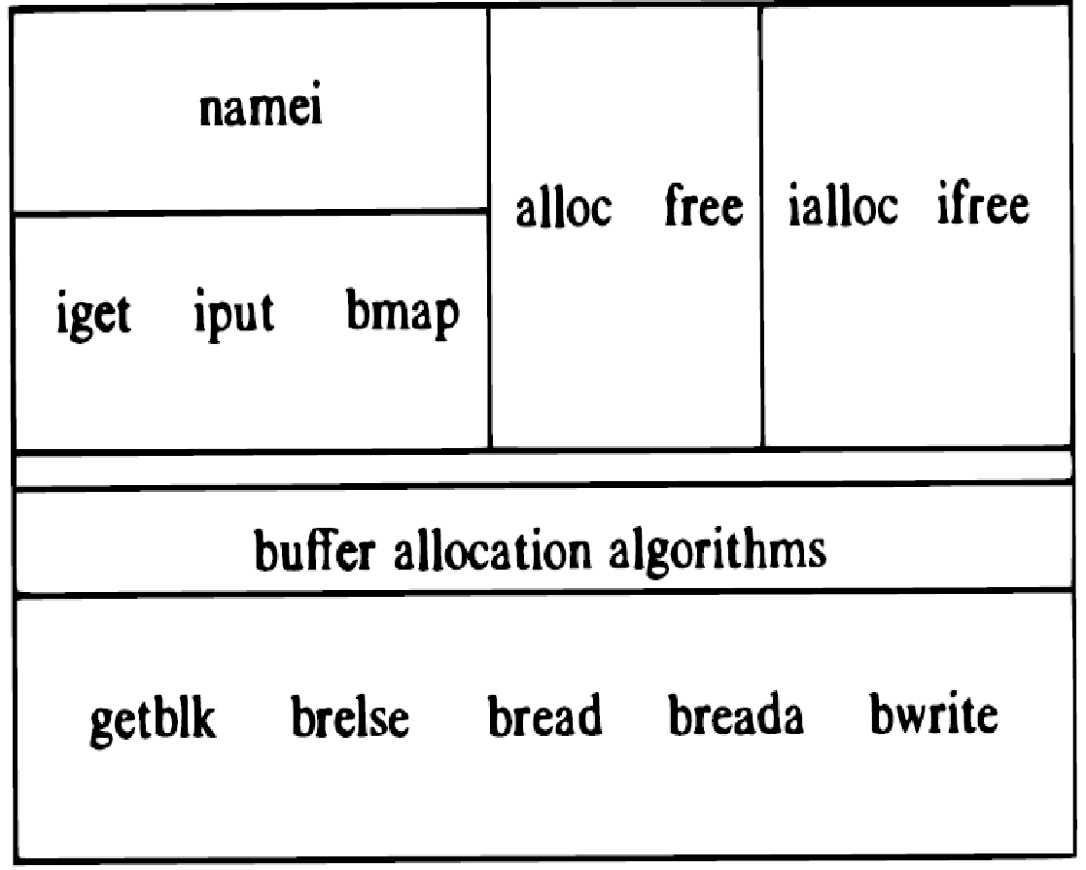
Low Level File System Algorithms
File System Algorithms
iget-returns a previously identified inode
iput- release the inode
bmap -sets kernel parameters for accessing a file
namei -converts a user level path name to inode using iget, iput and bmap
alloc and free allocates and free disk blocks for files
ialloc and ifree assign and free inodes for files

Slide 3
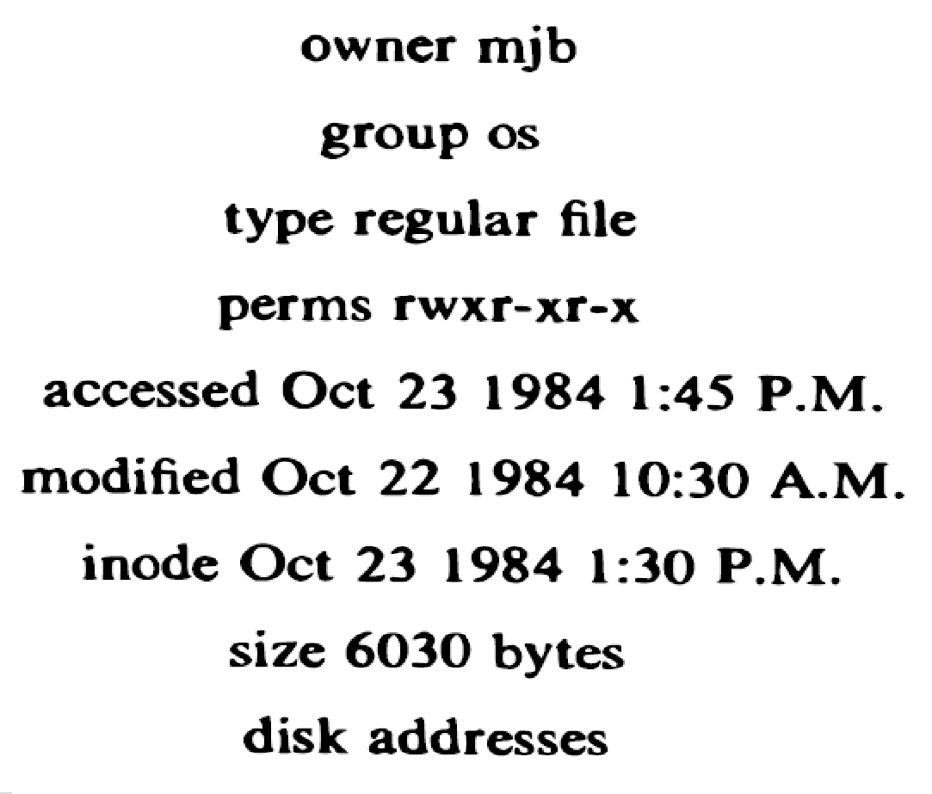
INODES
Disk inodes consist of following fields
File owner identifier- individual and group owner (Super user has access rights to all files in the system).
File Type -Regular, Directory, character or Block Special File
File Access Permission- The System protects files according to three classes the owner and the group owner and other users (read, write and execute)
File Access times- time the file was last accessed and modified file and inode modified.

Slide 4
INODES
Number of Links – number names the file has in the directory hierarchy
Table of Content for the disk addresses of data in a file. The users treat the data in a file as a logical streams of bytes, the kernel saves the data in discontinuous disk blocks
File Size- Data in a file is addressable by the number of bytes from the beginning of the file, starting from byte offset 0, and the file size is one greater than the highest byte offset of the data in the file.

Slide 5
In-Core INODES
The in-core copy of the inode contains the following fields in addition to the fields of the disk inodes
Status of the in-core inode
Locked
Waiting process for inode to become unlock
The in core representation of the file differs from the disk copy as a result of a change to the data in the inode
The in core representation of the file differs from the disk copy as a result of a change to the file.
File is a mount point
The logical device number
Inode number
Pointers to other in-core inodes (like Buffer pool free list and hash queue)
A reference count, indicating the number of instances of the file that are active

Slide 6
Structure of the Regular file
The inode contains the TABLE OF CONTENT (TOC) to locate a file data
If file occupies contiguous section on disk(linear sequence)then inode will contains,
Not suitable for simple file expansion and contraction
Disk Block number | Address on Disk
Start Block Address | File Size

Slide 7
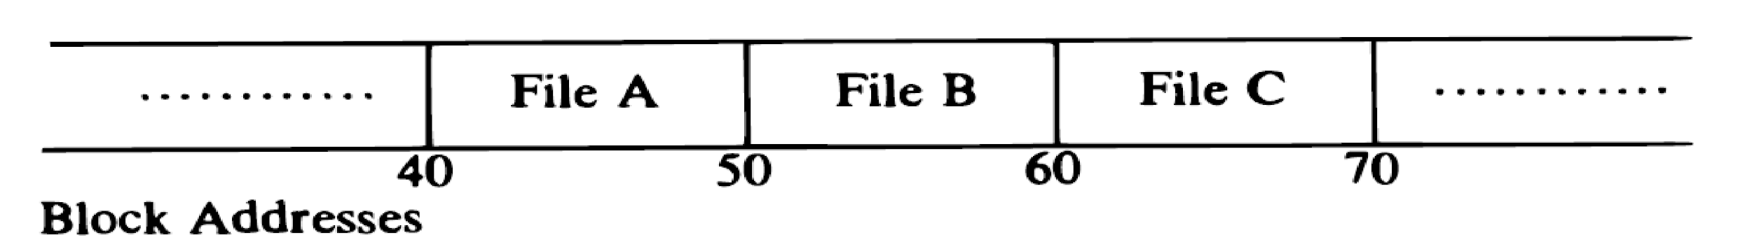
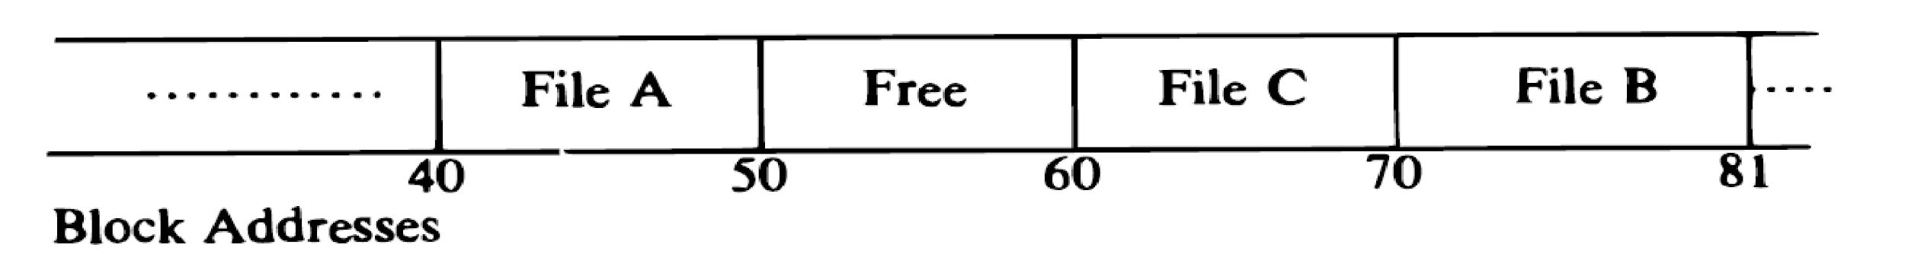
Structure of the Regular file
Following Diagram shows the problems of continuous allocation of file data and Fragmentation of free space.

Slide 8
Structure of the Regular file
Fragmentation can be solved using Compaction.
For greater flexibility,
Kernel allocates file space One Block at a Time
Spread data of file throughout the file system.
Inode table of Content will contain
If block size = 1K and File Size = 10K then inode Table of Content will have 10 entries. Similarly for 100K size, 100 entries in inode.
Disk Block Number | Address On Block

Slide 9
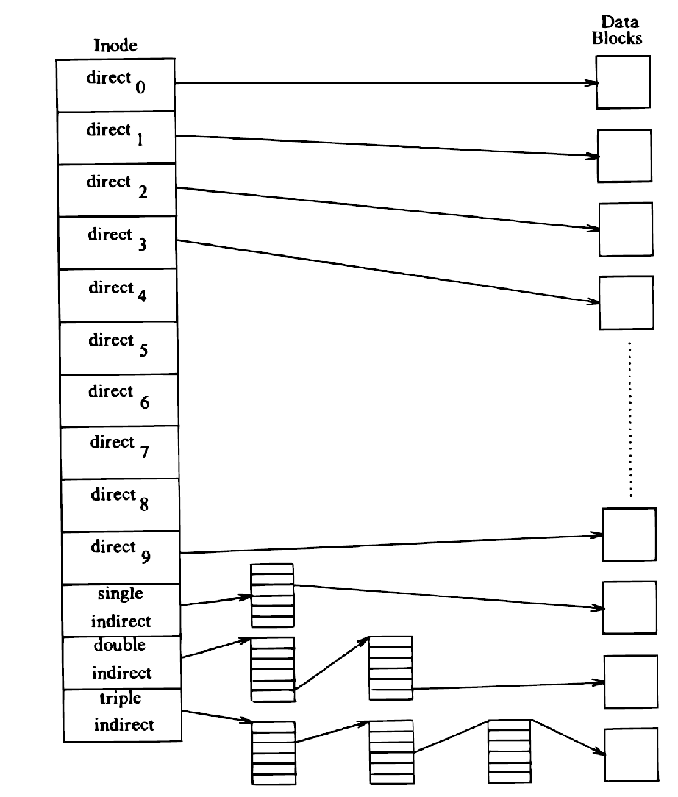
Structure of Regular file (TOC)
The System V UNIX system runs with 13 entries in the inode TOC.
The blocks marked
Direct- First entries from 0 to 9.
Single indirect
Double indirect
Triple indirect
Direct blocks directly points to the data block that contains real data
The block marked “Single indirect” refers to a block that contains a list of Direct block numbers, and then direct block points to the list of data block.
The block marked “Double indirect” contains a list of single indirect block numbers and then direct block and then data block.
The block marked “Triple indirect” contains the list of double indirect blocks and then single indirect block and direct and then data blocks.

Slide 10
Structure of Regular file (TOC)
Consider block layout in the following figure,
Assume that,
A logical block on the file system holds 1K bytes
Block number is addressable by a 32 bit integer
A block can hold up to 256 block numbers, then maximum number of bytes
10 direct blocks with 1K bytes each = 10 K bytes
1 indirect block with 256 direct blocks = 1K * 256 = 256 K bytes
1 double indirect block with 256 indirect blocks = 256K * 256 = 64 M bytes
1 triple indirect block with 256 double indirect blocks = 64M * 256 = 16 G bytes

Slide 11
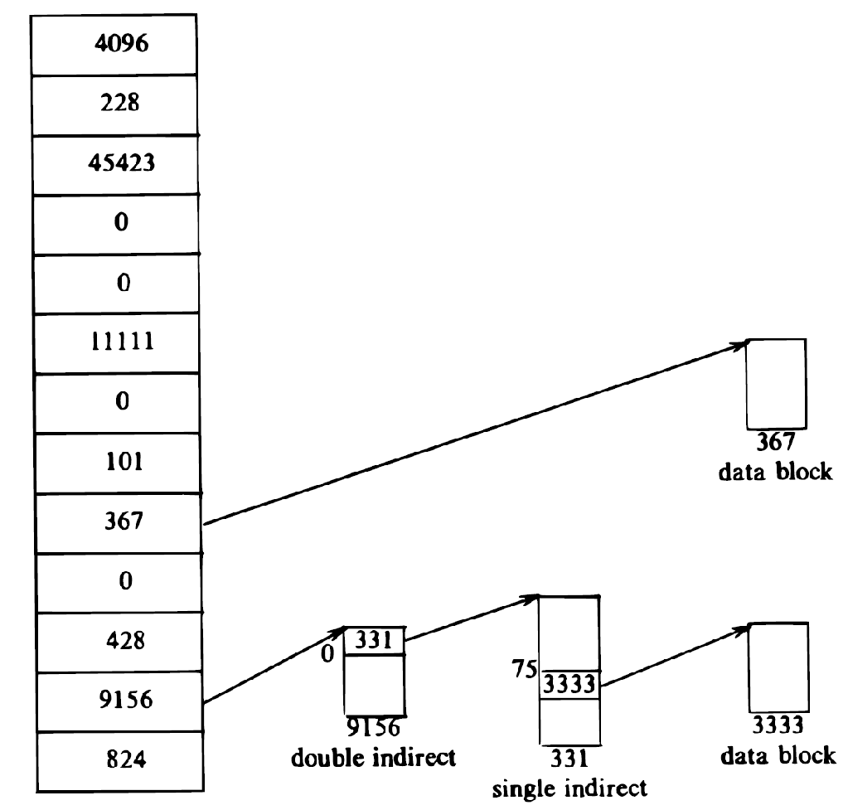
Example 1
Assume that a block contains 1024 bytes.
If a process wants to access byte offset 9000, the kernel calculates that the byte is in direct block 8
9000/1024 = 8.789 i.e. block no. 8 starting from 0
It then accesses block number 367; the 808th byte in that block is byte 9000 in the file
8*1024 = 8,192 byte offset are covered till 7th logical block
9,000- 8,192 = 808 remaining bytes are there in 8th logical block
Example2
If process wants to access byte offset 3,50,000 in the file, it must access a double indirect block, number 9,156 in the figure
3,50,000/1024 = 341.796 i.e. block no. 341 starting from 0
Direct and indirect block covers 266 blocks (10 + 256) and double indirect covers 256*256 blocks i.e. 65,536
Byte number 3,50,000 must be in 0th indirect block
341-256 = 75 and 75th block no. must be there in the 0th indirect block as it covers first 256 blocks of double indirect block
341*1024= 349,184 bytes are covered till 340th block
350000-349184=816 remaining bytes are there in the 341st block (75th block of 0th indirect block)

Slide 12
Conversion of pathname to an inode
With pathname also we can access file.
For that we are using an algorithm namei, it converts any pathname to an corresponding inode.
The algorithm namei parses the path name one component at a time.
Converts each component into an inode based on,
Its name
The directory being searched
Returns the inode of the input patname. Every process associated with a directory called Current Directory.
Namei uses intermediate inodes as its parses a pathname call them Working Nodes.

Slide 13
Conversion of pathname to an inode
The current directory of the first process in the system is Process 0- Root Directory.
The current directory of every other process start as the current directory of its parent process.
One process can change their directory using System Calls.
Every pathname start from the current directory of the process and pathname always starts from “/”.
During iteration kernel verifies that,
working node = directory
If it is not directory then system violates this working process.
Along with this system also checks the various permissions, suppose if permissions fails the search will also fails.

Slide 14
Conversion of pathname to an inode
For conversion kernel does a linear search of the directory file associated with working node, and match the pathname component to a directory entry name.
After this new inode becomes working inode.
If it finds a match,
It records the inode number of the related directory entry
Releases the block,old working directory
Allocates inode.
Suppose if it doesn't match, kernel releases the block and reads the next block.
Repeat this process until it matches the pathname component or it reaches the end of the directory.

Slide 15
Conversion of pathname to an inode
For example,
/ etc / passwd
When kernel start parsing, first it encounters “ / ”.
The kernel checks the next component “ etc ”.
After checking current inode is the “ / ” and with necessary permission and the kernel will searches the root for a file whose name is “etc”.
On finding the entry, the kernel releases the inode for root( using iput and iget alg).
After dicovering “etc” is a directory, kernel search etc block by block and search each entry at a time untill it locates entry for “passwd”.

Slide 16
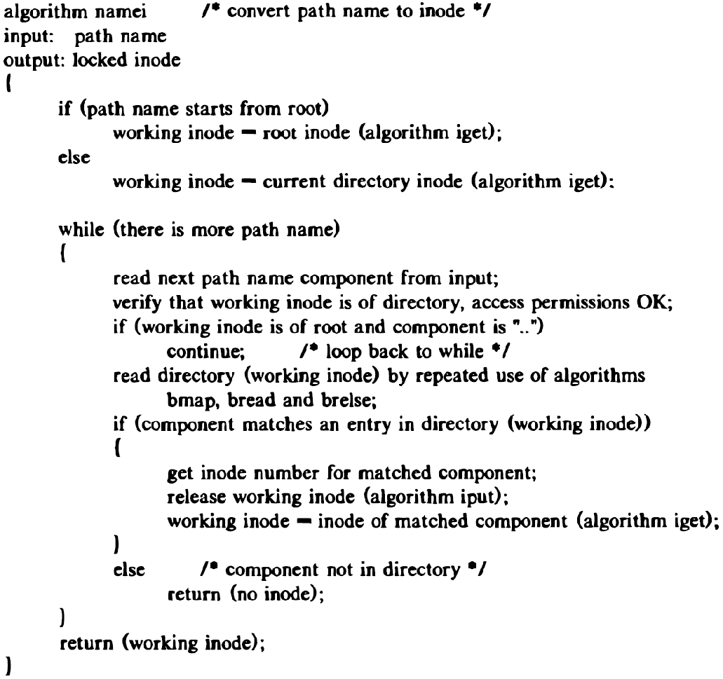
The Namei Algorithm

Slide 17
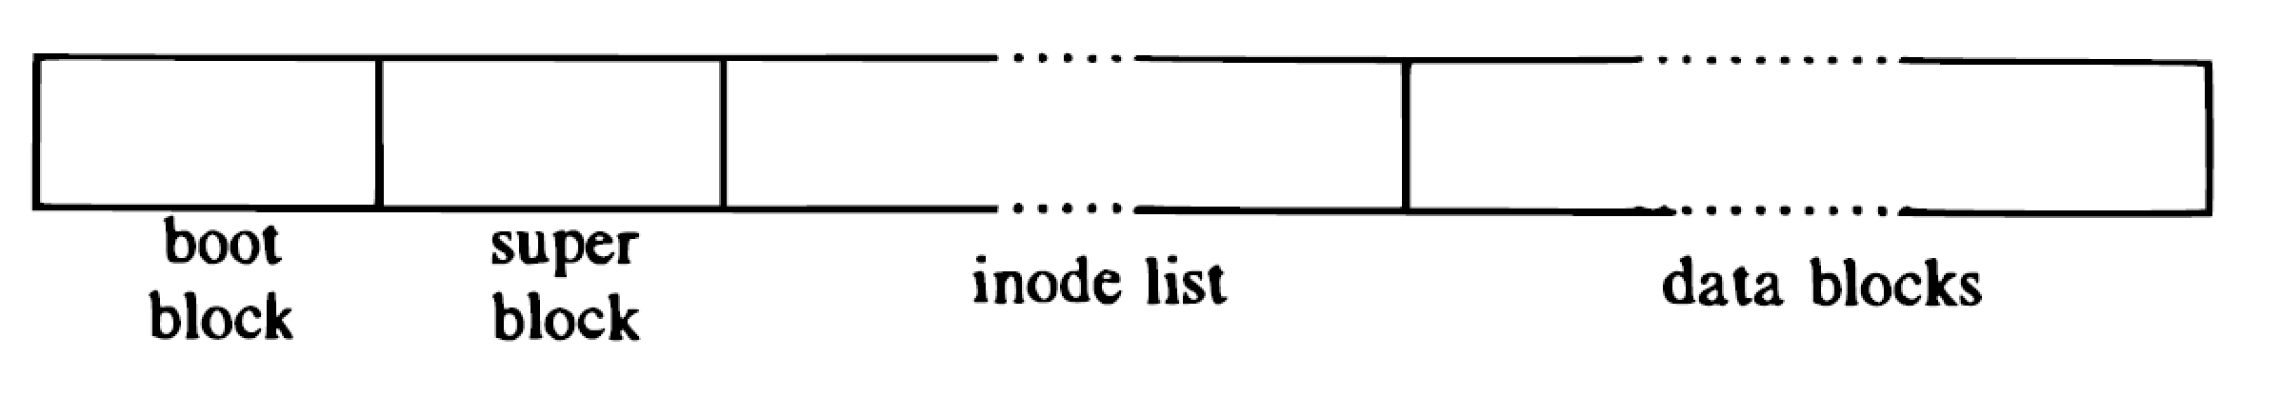
Super block
Super block consist of
The size of the file system
The number of free blocks in the file system
A list of free blocks available on the file system
The index of the next free block in the free block list
The size of the inode list
The number of free inodes in the file system
A list of free inodes in the file system
The index of the next free inode in the free inode list
Lock fields for the free block and free inode lists
A flag indicating that the super block has been modified

Slide 18
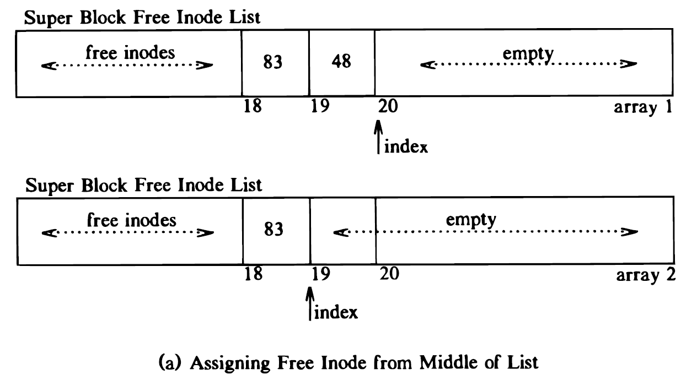
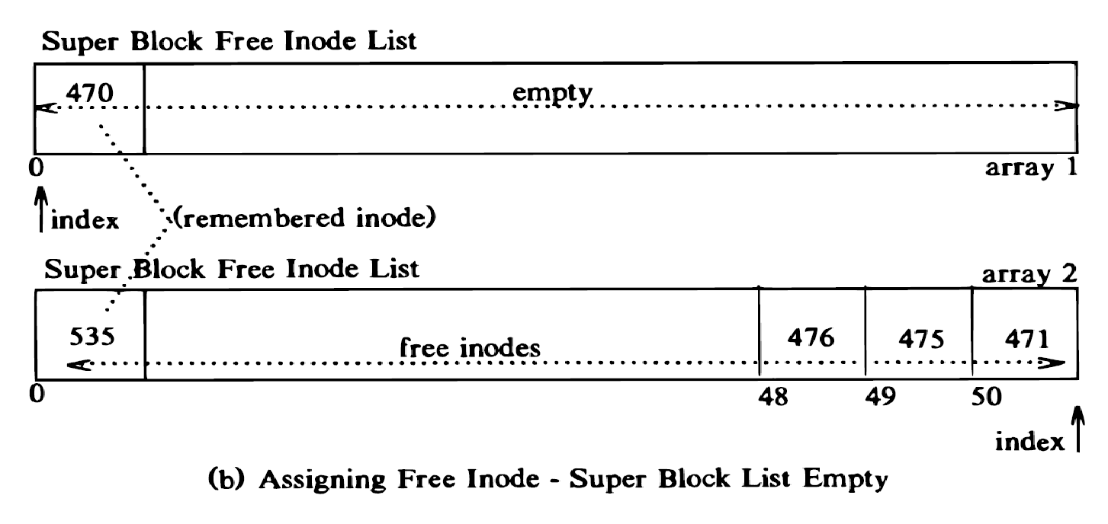
Inode assignment to a new file
The file system contains a linear list of inodes
An I node is free if its type field is zero
When the process needs a new inode, the kernel searches the inode list for a free inode using super block.
Super block contains an array to cache the number of free inodes in the file system
The kernel first verifies that no other process have locked access to the super block free inode list.
If the list of inode number in the super block is not empty, the kernel assigns the next inode number,
If the super block list of free inodes is empty, the kernel searches the disk and places as many free inode number as possible into the super block.
The kernel reads the inode list on disk, block by block , and fills the super block list of inode number to capacity, remembering the highest- numbered inode that it finds, calls that inode “remembered” inode
The next time the kernel searches the disk for free inodes it uses the remembered inode as its starting point
Free inode count is decremented in super block when inode is assigned

Slide 19
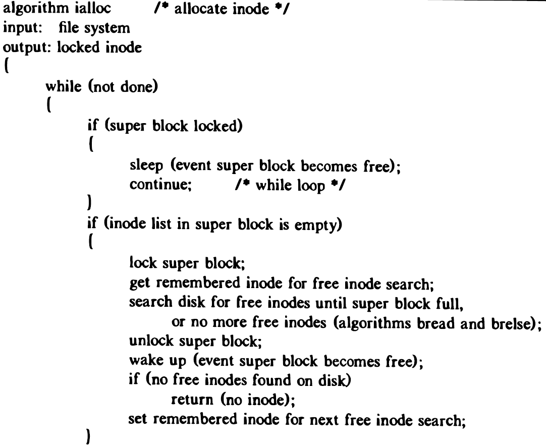
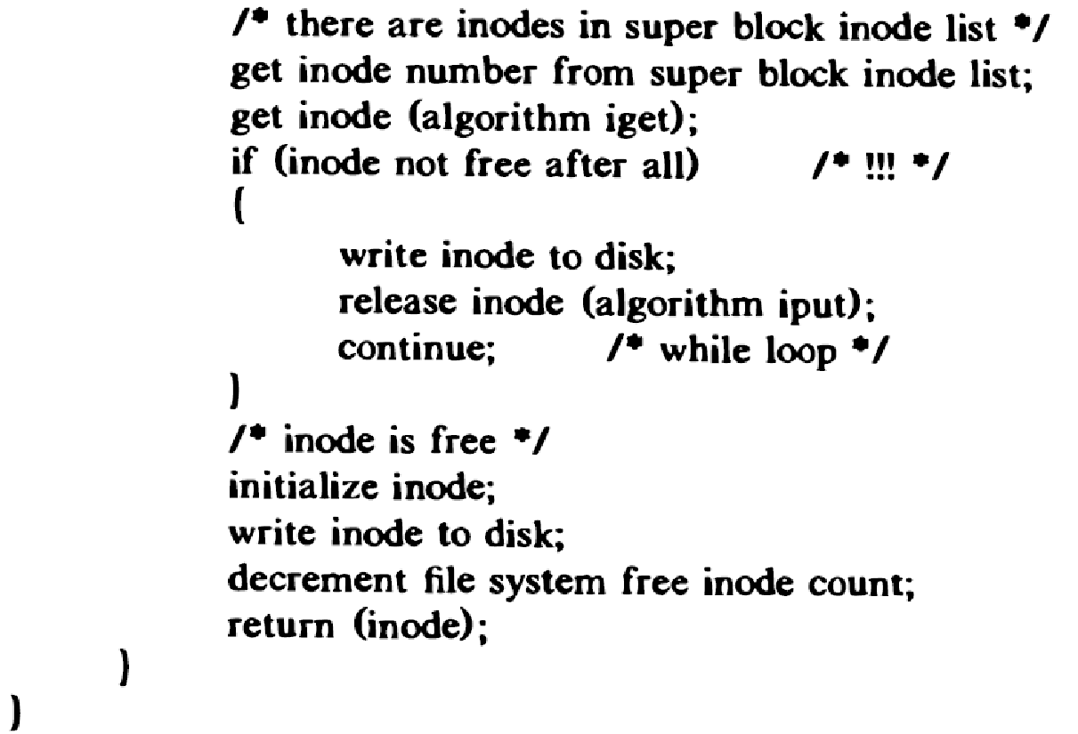
ialloc algorithm

Slide 20
Inode assignment to a new file
Process A Process B Process C
Assigns inode I from super block
Sleeps while reading inode(a)
Tries to assign inode from super block
Super block empty(b)
Search for free inodes on disk, puts inode I in super block (c)
use
the lock
Inode I in core
Does usual activity
Completes search, assigns another inode(d)
Assigns inode I from super block
I is in use!
Assign another inode(e)
Race Condition in Assigning Inodes

Slide 21
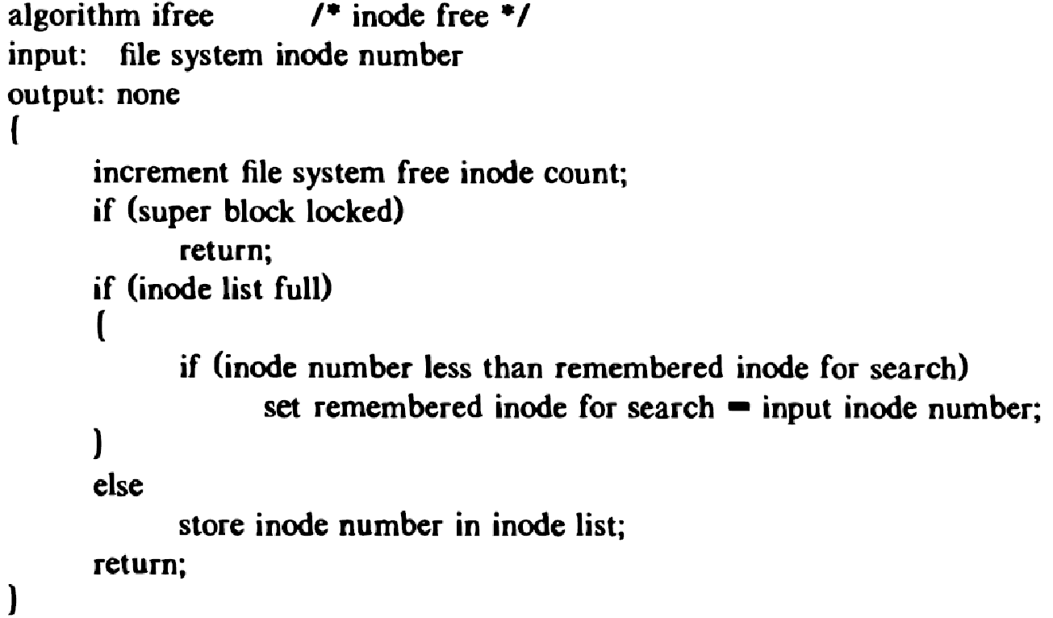
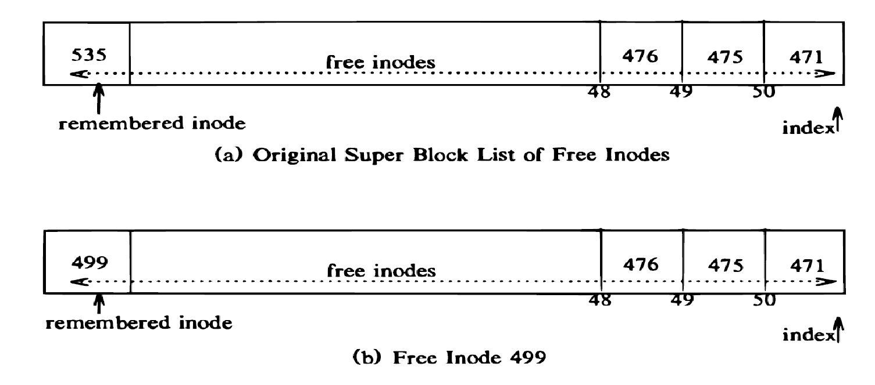
ifree algorithm

Slide 22
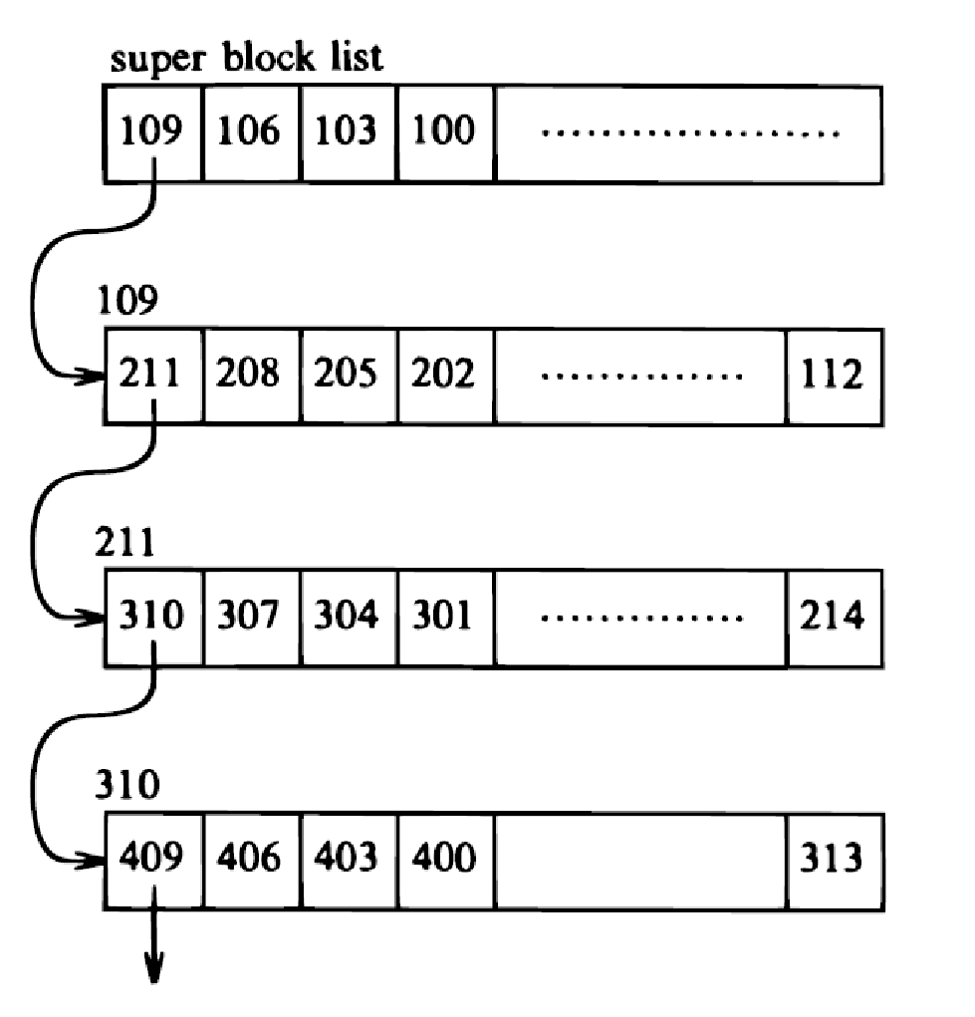
Allocation of disk blocks
When a process writes data to a file, the kernel must allocate disk from the file system for direct data blocks and sometimes for indirect blocks.
The file system super block contains an array that is used to cache the number of free disk blocks in the file system.
The utility program mkfs organizes the data blocks of file system in a linked list.
Each link in the list contains the array of free disk block numbers, and one array entry is the number of next block of the linked list
Kernel allocates the next available block in the super block list
If the allocated block is the last block in the super block cache, the kernel treats it as a pointer to a block that contains a list of free block numbers, and then proceeds to use the original block number
It allocates a buffer for the block and clears the buffer's data.

Slide 23
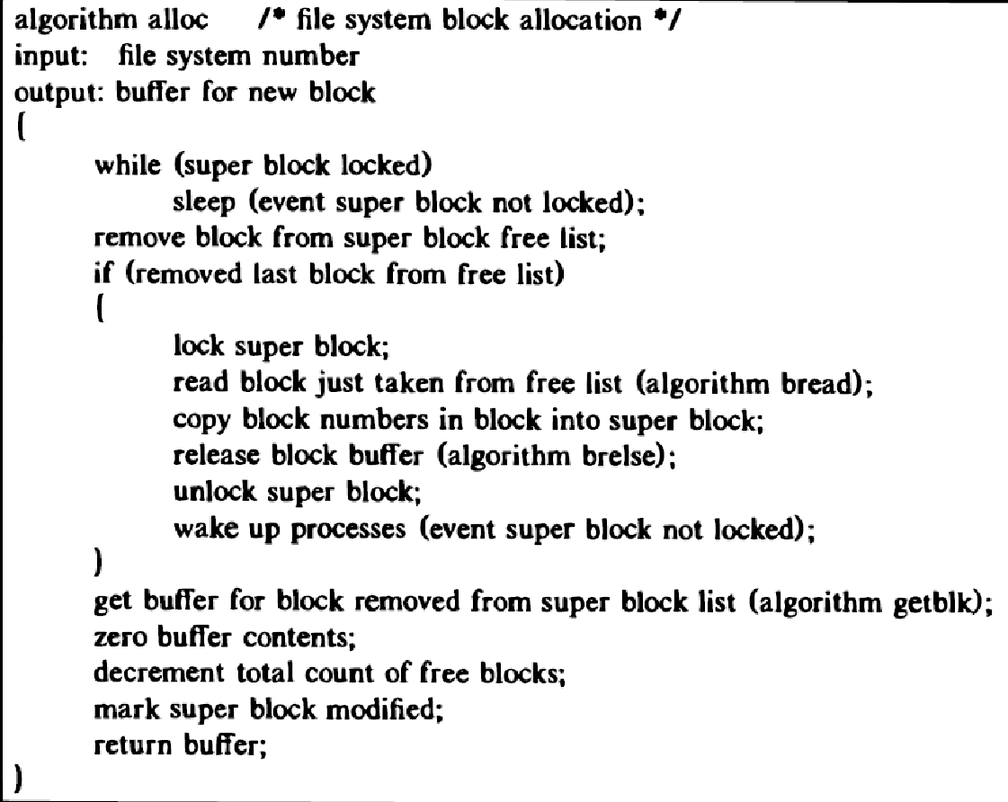

Slide 24
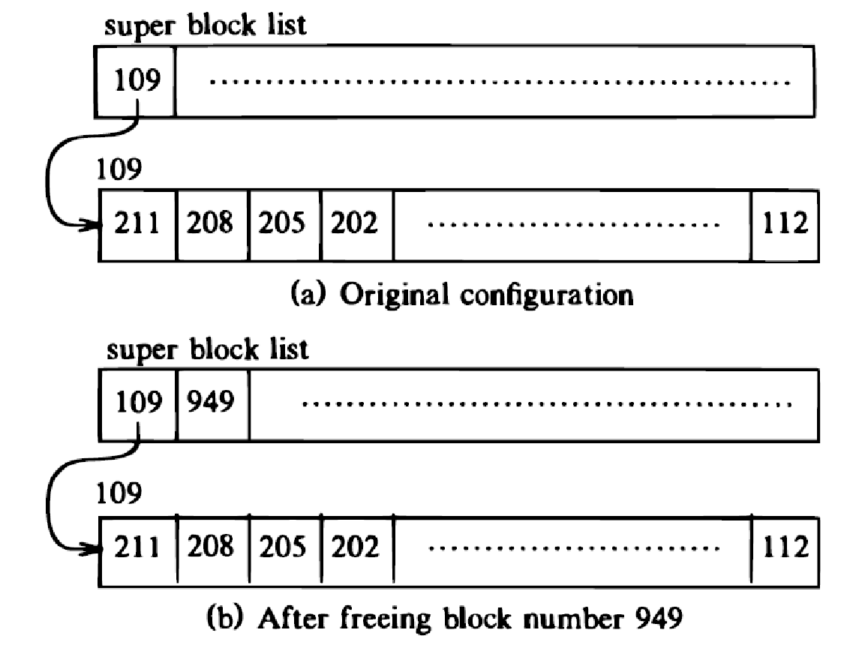
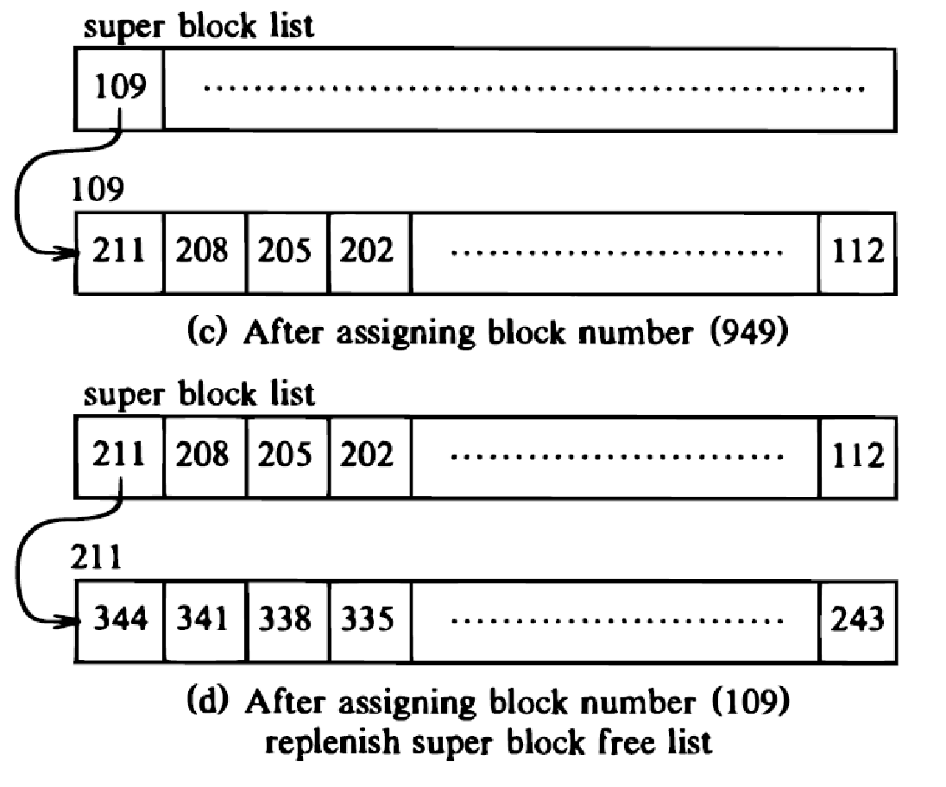
The algorithm for freeing a block Is the reverse of the one for allocating a block
If the super block list is not full, the block number of the newly freed block is placed on the super block list.
If the super block list is full, the newly freed block becomes a link block; the kernel writes the super block list into the block and rites the block to disk.
Kernel then places the block number of the newly freed block in the super block list

Slide 25
Other file types
pipe
fifo(first-in-first-out)
its data is transient: Once data is read from a pipe, it cannot be read again, no deviation from that order
use only direct block
special file
include block device, character device
the inode contains the major and minor device number
major number indicates a device type such as terminal or disk
minor number indicates the unit number of the device

Slide 26
References
The design of Unix Operating System - Maurice J. Bach (PHI)

